Slide 1




Astronomy 1010 chapter 4
Clayton State University
Slides for Astronomy textbook from OpenStax
https://openstax.org/books/astronomy/

Slide 2
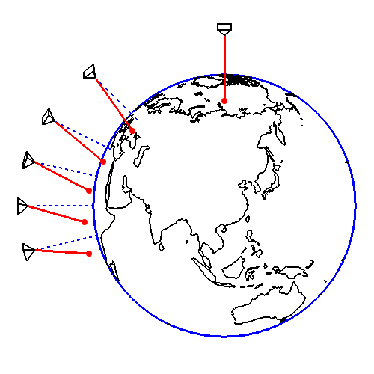
Foucault's pendulum
The Foucault pendulum (also Foucault's pendulum) is a simple device named after French physicist Léon Foucault and conceived as an experiment to demonstrate the Earth's rotation. The pendulum was introduced in 1851 and was the first experiment to give simple, direct evidence of the Earth's rotation.
https://de.wikipedia.org/wiki/Foucaultsches_Pendel

Slide 3
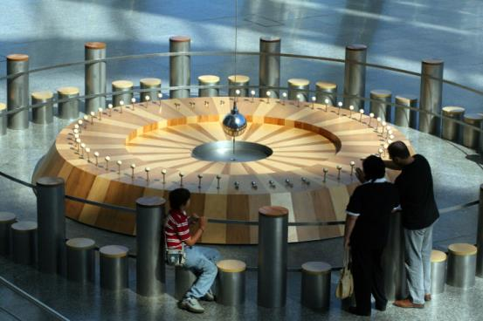
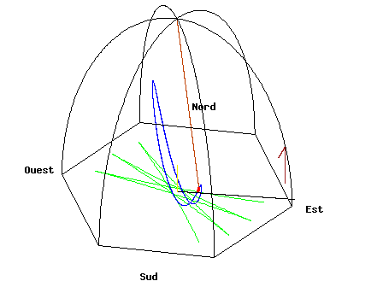
Foucault's pendulum - Figure 4.4
Foucault’s Pendulum. As Earth turns, the plane of oscillation of the Foucault pendulum shifts gradually so that over the course of 12 hours, all the targets in the circle at the edge of the wooden platform are knocked over in sequence. (credit: Manuel M. Vicente)
Animation adopted from https://en.wikipedia.org/wiki/Foucault_pendulum

Slide 4
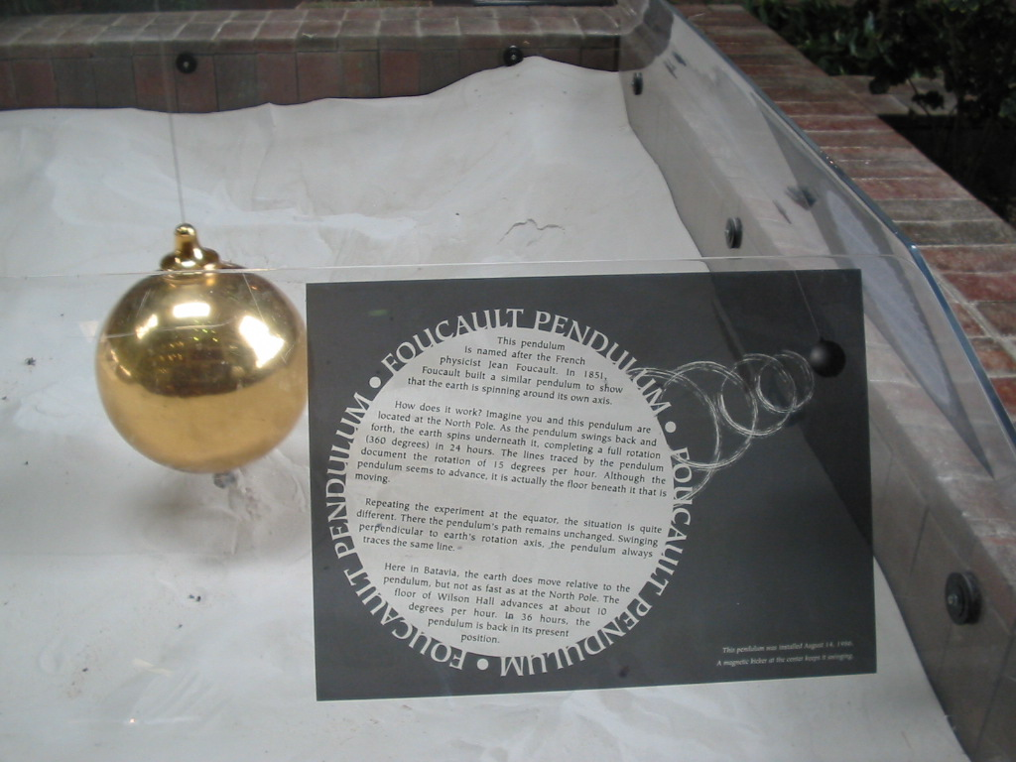
Foucault's pendulum
Foucault's pendulum at Wilson Hall, Fermi national Laboratory (www.fnal.gov). Photo is taken by me ☺

Slide 5
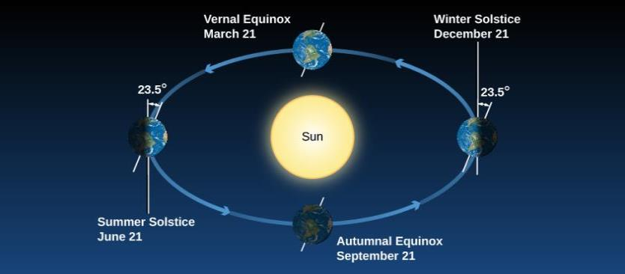
Seasons on Earth – Axis tilt
Figure 4.5
Seasons. We see Earth at different seasons as it circles the Sun. In June, the Northern Hemisphere “leans into” the Sun, and those in the North experience summer and have longer days. In December, during winter in the Northern Hemisphere, the Southern Hemisphere “leans into” the Sun and is illuminated more directly. In spring and autumn, the two hemispheres receive more equal shares of sunlight.

Slide 6
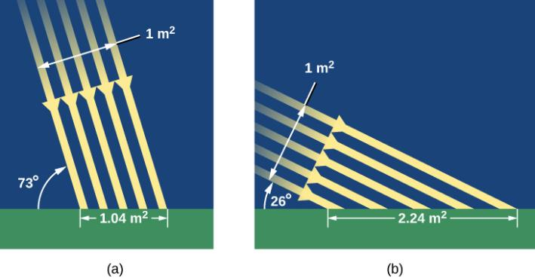
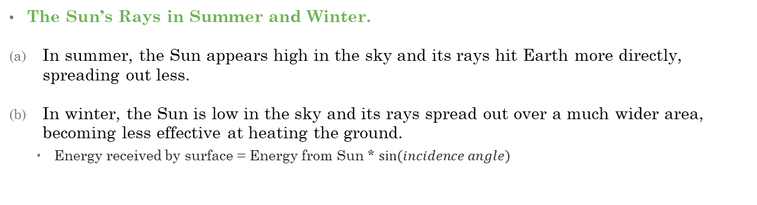
Seasons on Earth – Axis tilt
Figure 4.6
The Sun’s Rays in Summer and Winter.
In summer, the Sun appears high in the sky and its rays hit Earth more directly, spreading out less.
In winter, the Sun is low in the sky and its rays spread out over a much wider area, becoming less effective at heating the ground.
  Energy received by surface = Energy from Sun * $sin⁡(incidence angle)$

Slide 7
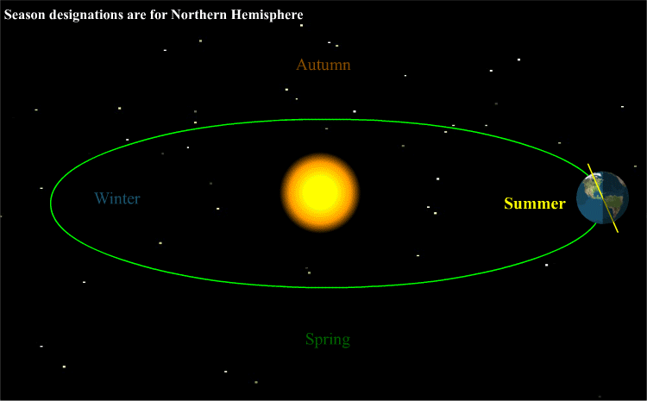
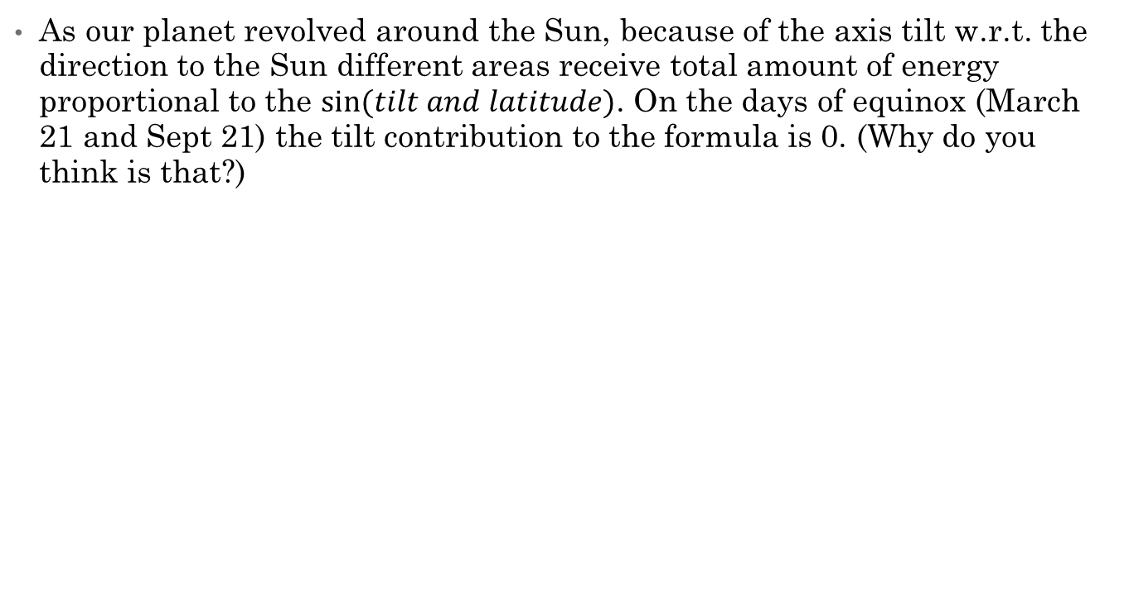
Seasons on Earth – Axis tilt
As our planet revolved around the Sun, because of the axis tilt w.r.t. the direction to the Sun different areas receive total amount of energy proportional to the $sin⁡(tilt and latitude)$. On the days of equinox (March 21 and Sept 21) the tilt contribution to the formula is 0. (Why do you think is that?)
Adopted from: https://www.e-education.psu.edu/eme811/node/642

Slide 8
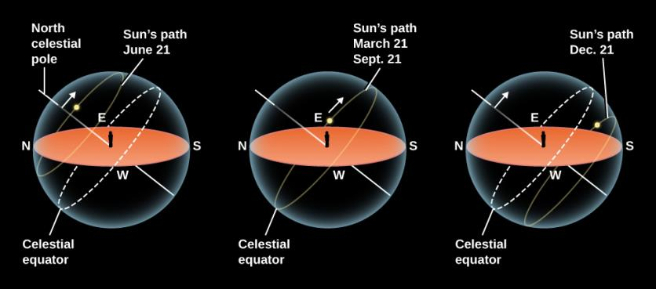
Seasons on Earth – Axis tilt
Figure 4.7
The Sun’s Path in the Sky for Different Seasons. On June 21, the Sun rises north of east and sets north of west. For observers in the Northern Hemisphere of Earth, the Sun spends about ~15 hours above the horizon in the United States, meaning more hours of daylight. On December 21, the Sun rises south of east and sets south of west. It spends ~9 hours above the horizon in the United States, which means fewer hours of daylight and more hours of night in northern lands (and a strong need for people to hold celebrations to cheer themselves up). On March 21 and September 21, the Sun spends equal amounts of time above and below the horizon in both hemispheres.
Where on Earth are day and night always equal?

Slide 9
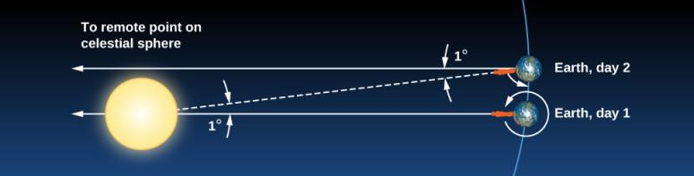
Calendars of the World
As we remember, the star Sirius (or Sothis) was very important to Egiptians. More then 4000 years ago they have adopted one of the first known calendars based on the heliacal rising of Sirius. It consisted of 365 days with no leap years, thus the months were actually shifting little by little . (see https://en.wikipedia.org/wiki/Sothic_cycle)
  The heliacal rising of a star occurs annually when it briefly becomes visible above the eastern horizon at dawn just before sunrise, after it has spent a season behind the sun rendering it invisible (https://en.wikipedia.org/wiki/Heliacal_rising)
Figure 4.10
Difference Between a Sidereal Day and a Solar Day. This is a top view, looking down as Earth orbits the Sun. Because Earth moves around the Sun (roughly 1° per day), after one complete rotation of Earth relative to the stars, we do not see the Sun in the same position.

Slide 10
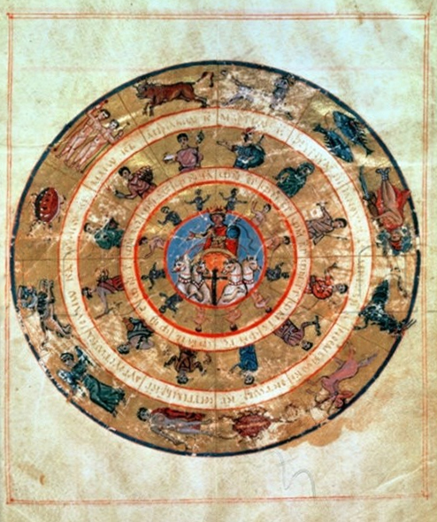
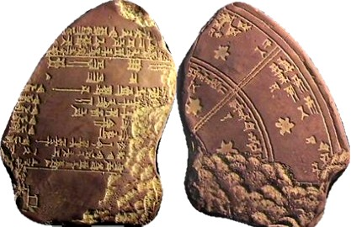
Calendars of the World
The Babylonian calendar was a lunisolar calendar with years consisting of 12 lunar months, each beginning when a new crescent moon was first sighted low on the western horizon at sunset, plus an intercalary month inserted as needed by decree. The calendar is based on a Sumerian (Third Dynasty of Ur) predecessor preserved in the Umma calendar of Shulgi (c. 21st century BC).
  Note: A lunisolar calendar is a calendar in many cultures whose date indicates both the Moon phase and the time of the solar year.
  Both the Jewish and Greek calendars used many ideas that originated in the Babylonian calendar.
Ancient Greek Calendar https://starryheaven.wordpress.com/tag/ancient-greek-calendar/
Babylonian calendar
https://sites.google.com/a/brvgs.k12.va.us/wh-15-sem-1-mesopotamia-fln/home/invention-page-sample/the-babylonian-calendar

Slide 11
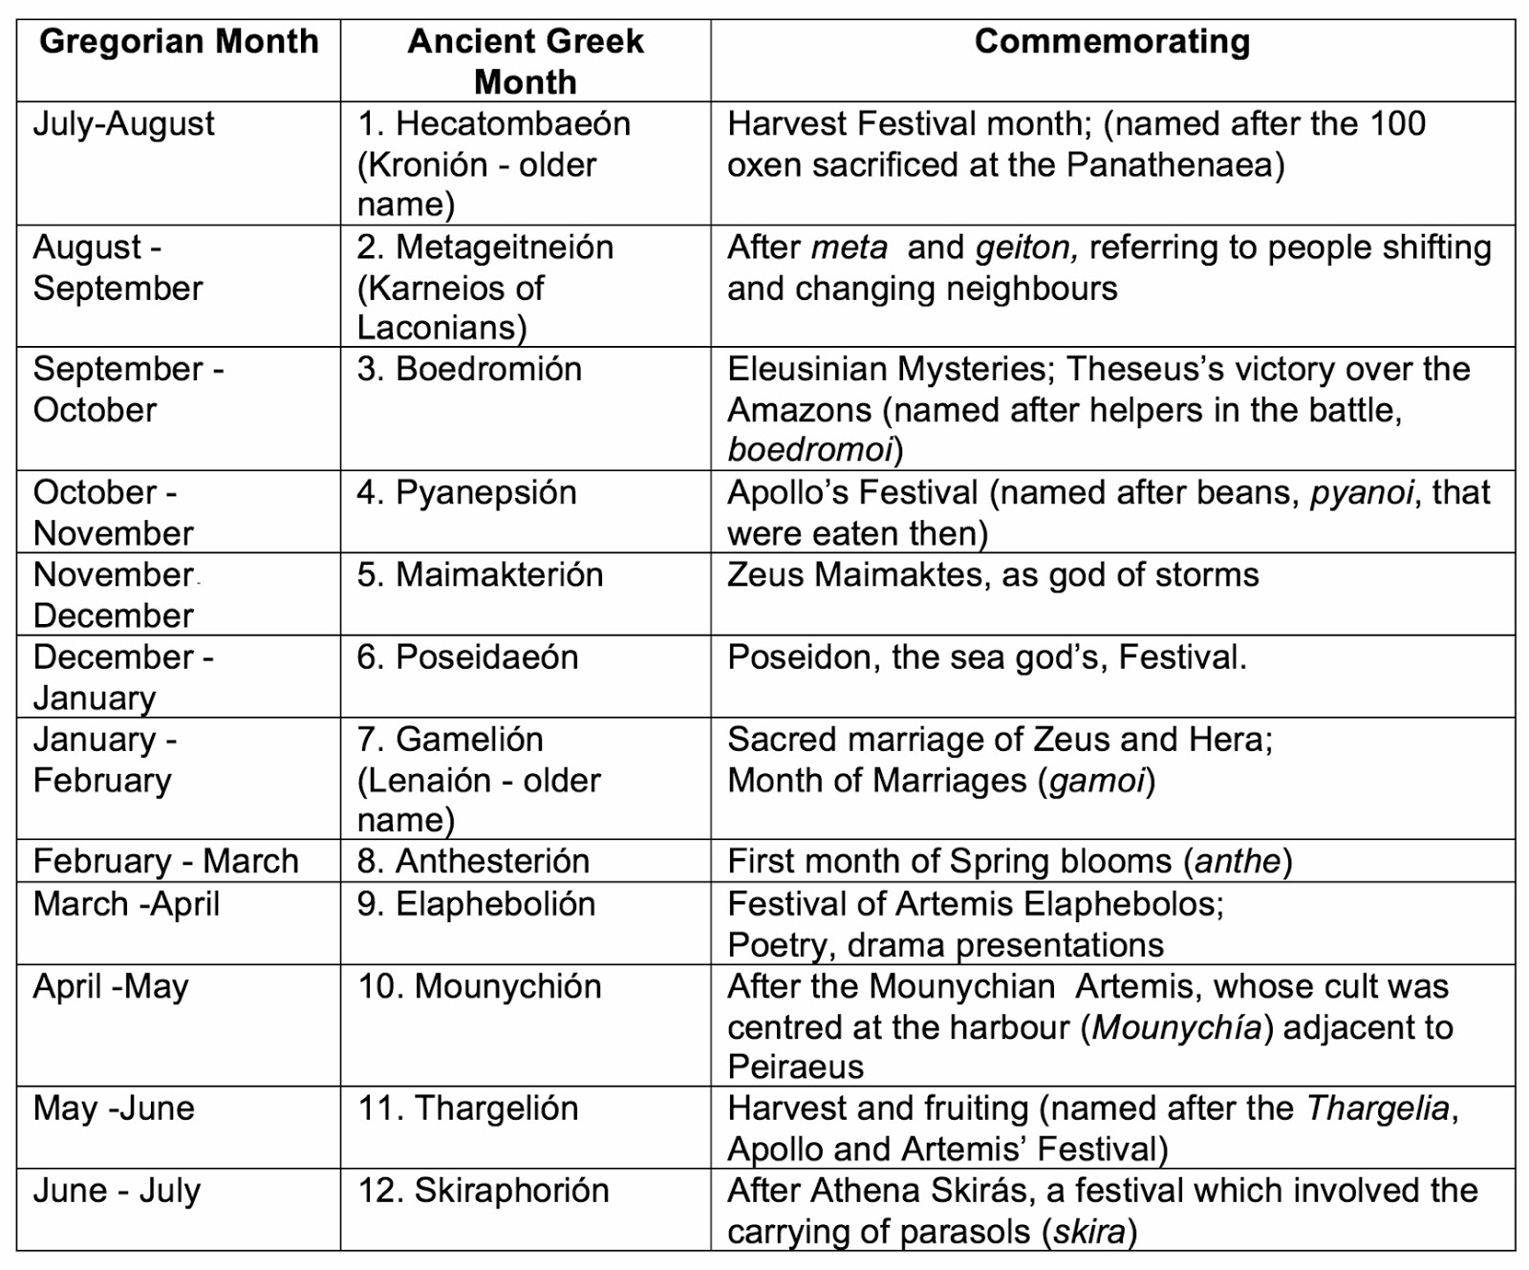
Calendars of the World
Refer to http://nicholasjv.blogspot.com/2015/07/the-ancient-greek-calendar.html for more information

Slide 12
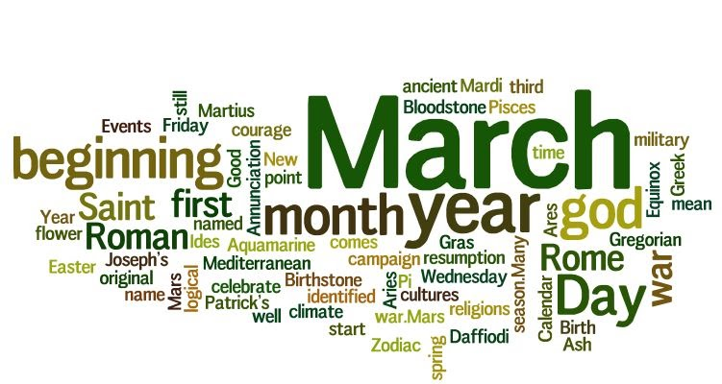
Months of the Year
Adopted in part from https://bestlifeonline.com/month-names/
March, the third month of our calendar, was formerly the first month of the year in the Roman Calendar.
  Still, many cultures will celebrate the new year on March 21
The start of the year was first changed by Julius Caesar in 46 BCE to coincide with the start of Senate session (and Roman fiscal year as well)
It's named after Mars, the Roman god of war, and also identified with the Greek god Ares. This month was considered the time to resume war, once the winter thawed out. As the Romans viewed war and fighting as a means to gaining lasting peace, this idea can provide an alternative perspective to the quote, "March comes in like a lion and goes out like a lamb."

Slide 13

Months of the Year
Adopted in part from https://bestlifeonline.com/month-names/
April is the month of Aphrodite, the Greek goddess of love and beauty. (In the Roman pantheon, she's known as Venus.) The word April comes from the Latin word apeire, which means to open, likely in connection with flower buds opening to bloom in the spring.
April is also marked by April Fools' Day, which takes place on the first day of the month, and is celebrated by playing pranks on others. It is believed that the tradition began in the 45 BCE after the shift from the old Roman calendar (where new year starts around the March equinox) to the Julian calendar (where the new year starts on January 1). Those who didn't know about the calendar switch, and stuck to the old system, were roundly mocked—and April Fool's stuck through the years.

Slide 14
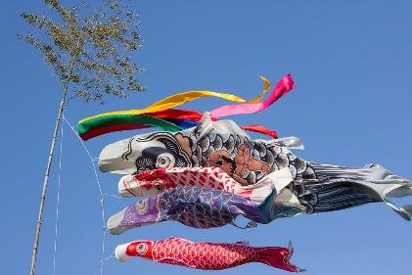
Months of the Year
Adopted in part from https://bestlifeonline.com/month-names/
May is derived from the French word Mai. It is named after Maia, the goddess of spring and growth. Maia is also the daughter of Faunus, one of the oldest Roman deities and the wife of Vulcan. Also, in Greek mythology, Maia is known as the mother of Hermes. The Greeks and Romans saw Maia as a nurturer filled with warmth and plenty—kind of like May.
An interesting fact about May is in Japan, there is a condition known as May Sickness referred to as Gogatsu-byou. As the Japanese school year begins on April 1st, and many changes take place at that time of the year, Gogatsu-byou is a type of depression that affects new students and employees after a few weeks of adjusting to a suddenly busier life.

Slide 15
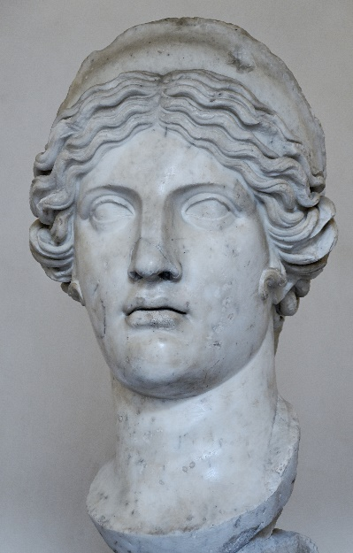
Months of the Year
Adopted in part from https://bestlifeonline.com/month-names/
June is named after Juno, the Roman goddess of love and marriage, and also the de facto deity-counselor of the Roman state. (Hera is her Greek equivalent.)
In Roman mythology, Juno watched over pregnant woman and children and insured safe births, which is why getting married in June is considered good luck. When looking at its goddess name origin, June is not only an ideal time for weddings, but it's also a good month for renewing vows.

Slide 16

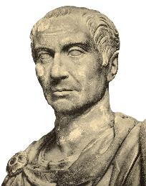
Months of the Year
Adopted in part from https://bestlifeonline.com/month-names/
July was initially known as Quintilis, or "the fifth month," which it was on the Julian calendar. July was named in honor of Julius Caesar after his death in 44 B.C.E., as he was born during this month. In fact, July is the first month of the calendar which is named after a real person.
For those who live in the Northern Hemisphere, it's the month known for its hot summer days. July is the month to head to the beach, pool, and playground, and take part in many other outdoor activities. (In the States, people revel in Independence Day celebrations, too.) On the other hand, in the Southern Hemisphere, July is a month for reflection and meditation as it falls in the middle of the cold, dark winter

Slide 17
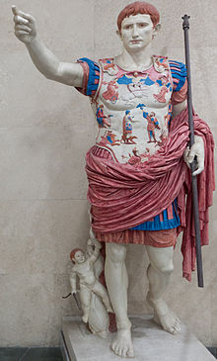
Months of the Year
Adopted in part from https://bestlifeonline.com/month-names/
Historical fact: it has been recently discovered that all ancient Greek and Roman statues were, in fact, colored.
The month of August was originally called Sextilis, from the Latin word sextus, meaning six.
Its name was changed in honor of the Roman emperor Augustus, Julius Caesar's great-nephew. Augustus was an emperor who brought peace to a very conflicted area, and inspired growth, reform, and a stronger infrastructure within its cities.
It became the eighth month in when January and February were moved to the beginning of the year thus a change in name was felt necessary by Augustus.

Slide 18
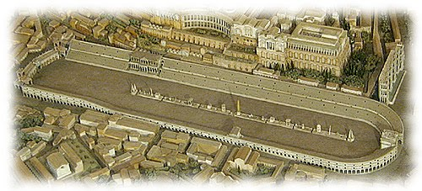
Months of the Year
Adopted in part from https://bestlifeonline.com/month-names/
Just like Quinitlis and Sextilis, September comes from the Latin term septem, meaning seven. September was originally the seventh month in the ancient Roman.
For the Romans, September was known for the celebration called Ludi Romani, which lasted several weeks and featured chariot races, gladiatorial contests, and lots of feasts. In the spiritual sense, September can be thought of as the month that we celebrate our own personal victories and accomplishments.

Slide 19
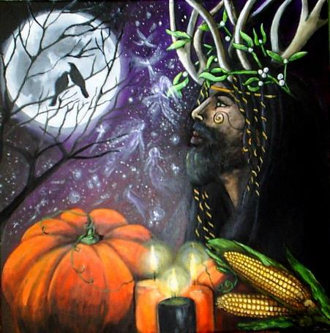
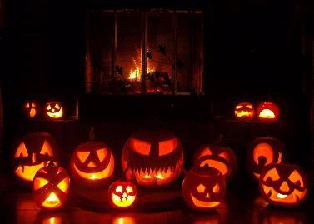
Months of the Year
Adopted in part from https://bestlifeonline.com/month-names/
Samhain is the Celtic New Year day
Now we know it as Halloween
October is derived from the word octo, which means eight, as it was the eighth month of the Roman calendar, and later became the tenth month in Julian/Gregorian calendar. October is marked by many festivals taking place around the world, including Oktoberfest in Germany and the Aloha Festival in Hawaii, which is also known as the Mardi Gras of the Pacific.
It's also National Cookie Month, National Pizza Month, National Popcorn Month, National Dessert Month, National Pretzel Month, National Seafood Month, National Sausage Month, and National Pasta Month. Yum.

Slide 20

Months of the Year
Adopted in part from https://bestlifeonline.com/month-names/
November is derived from the Latin word novem, which means nine.
Just like the others, its name stuck, even after January and February were shifted to the calendar start, making November the eleventh month.
In the United States, November is associated with the much-anticipated Thanksgiving holiday, which involves lots of eating, a four-day weekend, and Black Friday, the start of the Christmas holiday season and the busiest shopping day of the year.

Slide 21
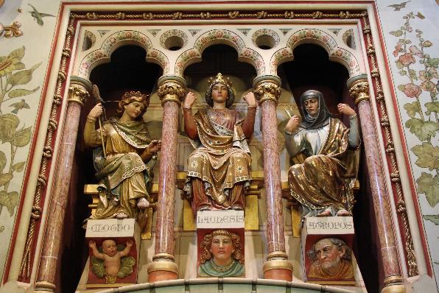
Months of the Year
Adopted in part from https://bestlifeonline.com/month-names/
December comes from the Latin word decem, meaning ten. It was the tenth month of the Julian calendar, and now is the twelfth and last month of the year. The Latin name is derived from Decima, the middle Goddess of the Three Fates, and the one who personifies the present.
  Think of the Christmas Carol by Walter Scott…
In the Northern Hemisphere, December is not only the start of winter but is also known for having the shortest day of the year with the least amount of daylight hours on December 21.

Slide 22
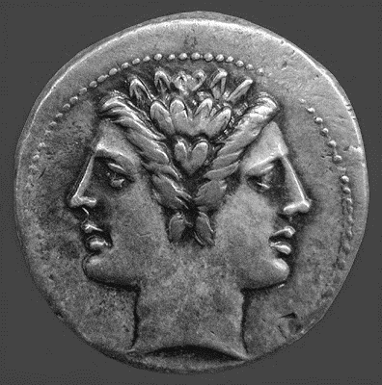
Months of the Year
Adopted in part from https://bestlifeonline.com/month-names/
The month of January is named after Janus, the Roman god of gates and doorways.
Janus is represented with two heads that are back-to-back, which signifies that he is looking back at the past for perspective, as well as forward to the future for hope. His duality perfectly coincides the end of one year and the start of the next.
January is marked with renewal and fresh beginnings, which is why it's the month of resolutions, to make positive changes for the year ahead.

Slide 23
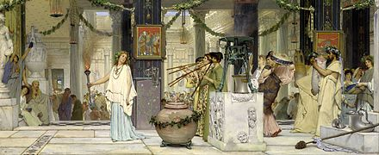
Months of the Year
Adopted in part from https://bestlifeonline.com/month-names/
The name February is derived from the Roman period of Februa, which was a festival of purification.
Also called the festival of Lupercalia, it was named after the Roman God Februus, who represented purification. In fact, William Shakespeare's play Julius Caesar begins during Lupercalia. This festival took place on the 15th day of the month and involved some usual cleansing rituals to improve health and fertility.
February is the only month to have 28 days—except during the Leap Year, when it has 29. According to an Irish tradition, a woman can ask a man to marry her on this day and have better luck of him saying yes.

Slide 24

Any Questions?

